Slide 1
Module 1 – introduction to 8086

Slide 2
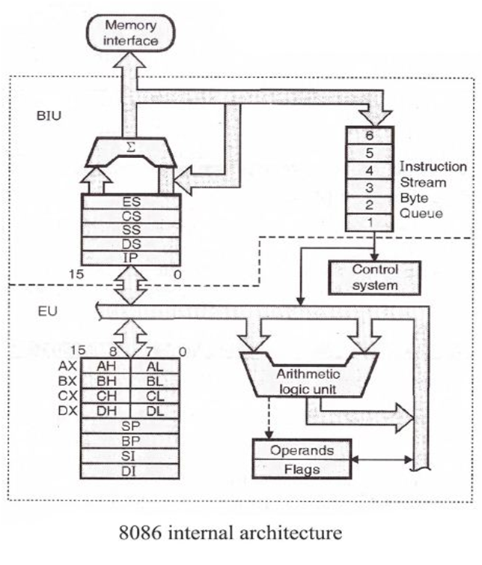
Architecture of 8086
Source: https://www.includehelp.com/embedded-system/architecture-of-8086-microprocessor.aspx as on 17 July 2020

Slide 3
Memory segmentation
To increase the fetching speed and the execution speed, the memory is segmented in 8086
20 bit address bus can address 1MB of memory
It is divided into 4-64kB segments
Thus, among 1 MB memory, 8086 uses only 4 64kB segments

Slide 4
Internal architecture
Internal architecture of 8086
Bus Interface Unit (BIU)
Execution Unit

Slide 5
1. Bus interface unit (BIU)
System bus is used to provide interface between the system memory and I/O devices
Performs various jobs such as memory read, I/O read etc.

Slide 6
Functions of BIU
Generates 20 bit physical address for accessing memory
Obtains instructions from memory
Transfers data from and to the I/O and memory
Pipelining – fetches 6 instructions in prior
BIU contains
4 Segment registers
Instruction Pointer
Address Generation Circuit

Slide 7
Instruction Pointer
16 bit registers
Holds the offset of the next instructions in the code segment
It is incremented after every instruction byte is obtained
Address of net instruction is calculated as CSx10H+IP

Slide 8
Registers
Code segment register – Holds the base address of the code segment. Every program is stored in the CS and each instruction is accessed with the help of instruction pointer
Data Segment register – Holds the base address for data segment
Stack segment register – Holds the base address for stack segment
Extra segment register - Holds the base address of the extra segment

Slide 9
Address generation
BIU generates the address
Generates 20 bit address using segment and offset addresses
Segment address x 10H + Offset Address

Slide 10
6 byte prefetch queue
It is a 6 byte queue (FIFO)
Fetches the next instruction when executing the current instruction – pipelining
Erased whenever a branch instruction occurs

Slide 11
2. Execution unit
Main components
General purpose registers
ALU
Special Purpose registers
Instruction register
Instruction decoder
Flag/status register

Slide 12
Functions
Obtains instructions form the queue in BIU, decodes them and performs arithmetic and logical operation using ALU
Sends control signals for internal data transfer
Sends request signals for accessing I/O devices
Operates with respect to clock cycles

Slide 13
General Purpose registers
4 16 bit general purpose registers
AX register – holds operands during arithmetic operations. Used as accumulator during string operations
BX register – Holds the memory address (offset)
CX register – holds count for instructions such as loop, rotation, shifting, string operations etc.
DX register – Used with AX register to hold a total of 32 bit value during multiplication and division

Slide 14
Arithmetic and Logical unit
Performs 8 and 16 bit arithmetic operations

Slide 15
Special purpose registers
Stack pointer – points to the top of the stack. Used during PUSH, POP, CALL etc.
Base Pointer – Holds the Offset address of any location in the stack segment. To access random locations in the stack.
Source Index – Holds offset address in data segment during string operations
Destination index – Holds the offset address in the Extra segment during string operations

Slide 16
Flags/Status register
6 Status Flags
Carry Flag
Parity Flag
Auxiliary carry flag
zero flag
Sign flag
Overflow flag
3 Control Flags
Trap Flag
Interrupt Flag
Direction Flag

Slide 17
weblinks
https://www.geeksforgeeks.org/architecture-of-8086/
https://www.tutorialspoint.com/microprocessor/microprocessor_8086_overview.htm#:~:text=8086%20Microprocessor%20is%20an%20enhanced,like%20multiplication%20and%20division%20easily.
https://stackoverflow.com/questions/36442060/why-is-any-value-saved-in-a-segment-register-multiplied-by-10

